Slide 1
IP Addressing and Subnetting
Notes:
Evaluation link

Slide 2
Objectives
Upon completion, you will be able to:
Discuss the Types of Network Addressing
Explain the Form of an IP Address
  Network ID
  Host ID
Discuss the Classes of IP Addresses
Understand the Function of the Mask

Slide 3
Let’s Talk About Addressing!
Types of Addressing:
- Layer 2 – MAC Addresses (Media Access Control)
0134.2345.12AB
0134.23
45.12AB
A MAC Address Vendor Code Serial Number
- Layer 3 – Logical Addresses (IPv4 or IPX)
Assignment of IP Addresses:
  Static Addresses – assigned by an Administrator
  Dynamic Addresses – DHCP
  “Hierarchical” vs. “Flat” Addressing Schemes

Slide 4
Can You Count in Binary?
We are Very Familiar with our Decimal System…
0 1 2 3 4 5 6 7 8 9…10 11 12 13…
But,
We Need to Become Familiar with the Binary System…only 0’s and 1’s
0000 | 1 10 | 11 | 100 | 101 | 110 | 111 | 1000 | 1001…
0 | 1 2 | 3 | 4 | 5 | 6 | 7 | 8 | 9

Slide 5
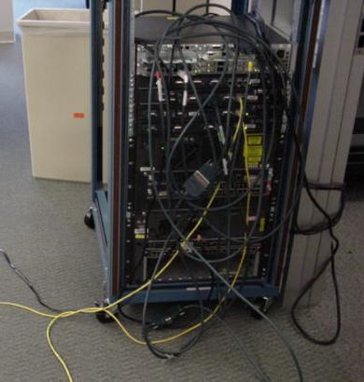
Basics of An IPv4 Address
Layer 3 (L3) Logical IP Addresses are comprised of 4 Octets, separated by a .
The Decimal form looks like this:
176.223.14.127
The Binary form looks like:
128 64 32 16 8 4 2 1
10110000.11011111.00001110.01111111

Slide 6
Basics of An IPv4 Address
Each of the 4 Octets has 8 Bits
Each of these Bits has a “Binary Value”
Each Bit can only be a One or a Zero
Let’s Look at One of the Octets – 8 Bits
128 64 32 16 8 4 2 1
Each of these 8 bits has a distinct value, that starts at “1” from the right side and moving to the left, doubles each time to 2, 4, 8, 16, 32, 64, and finally 128, as shown above.

Slide 7
IPv4 Addressing
32 bits
Dotted Decimal
Network Host
Maximum
255 | 255 | 255 | 255
1
8 9
16 17
24 25
32
Binary
 | 11111111 |  | 11111111 |  | 11111111 |  | 11111111
 | 128 64 32 16 8 4 2 1 |  | 128 64 32 16 8 4 2 1 |  | 128 64 32 16 8 4 2 1 |  | 128 64 32 16 8 4 2 1
 | 172 |  | 16 |  | 122 |  | 204
Example Decimal
Example Binary
10101100
00010000
01111010
11001100

Slide 8
IPv4 Address Classes
Class A:
Class B:
Class C:
Class D:
Class E:
8 bits
8 bits
8 bits
8 bits
Network | Host | Host | Host
Network | Network | Host | Host
Network | Network | Network | Host
Multicast Research

Slide 9
IPv4 Address Classes
Bits:
1 8 9
16 17
24 25
32
0NNNNNNN
Host
Host
Host
Class A:
Range (1-127) – 16,777,214 hosts
Bits:
1 8 9
16 17
24 25
32
10NNNNNN | Network
 |  | Host |  | Host
Class B:
Range (128-191) – 65,534 hosts
Bits:
1 8 9
16 17
24 25
32
110NNNNN
Network
Network
Host
Class C:
Range (192-223) – 254 hosts
Bits:
Class D:
1 8 9
16 17
2425 32
1110MMMM
Multicast Group Multicast Group Multicast Group
Range (224-239)

Slide 10
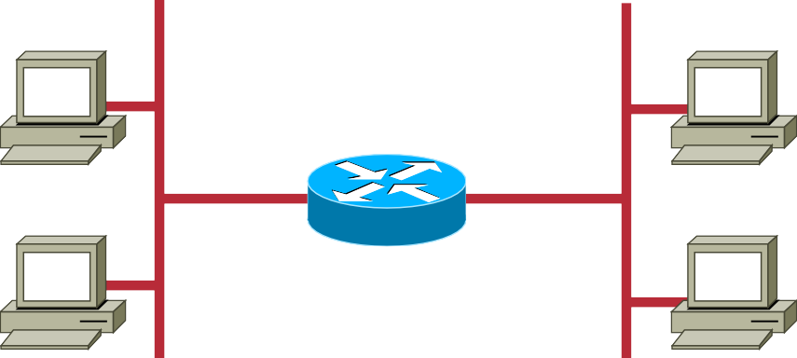
Host Addresses
172.16.2.1
10.1.1.1
10.6.24.2
E1
172.16.3.10
E0 172.16.2.1
10.250.8.11
172.16.12.12
10.180.30.118
Routing Table
Interface E0
E1
172.16 . 12 . 12
Network Host
Network
172.16.0.0
10.0.0.0

Slide 11
Determining Available Host Addresses
Network
Host
172
16 0 0
16
15
14
13
12
11
10
9
8
7
6
5
4
3
2
1
N
10101100 00010000 00000000 00000000
00000000 00000001
00000000 00000011
1
2
3
65534
65535
65536
Remember 2^{N}-2 (where N is the number
of host bits)
...
...
...
11111111 11111101
11111111 11111110
11111111 11111111
- 2
2^{N}-2 = 2¹⁶-2 = 65534
65534

Slide 12
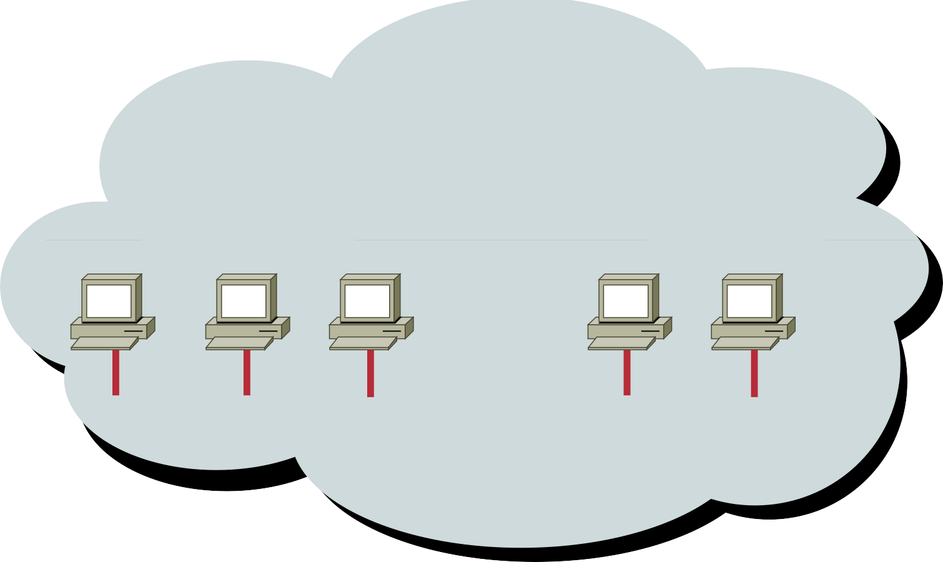
Addressing without Subnets
172.16.0.1 172.16.0.2 172.16.0.3
172.16.255.253 172.16.255.254
…...
172.16.0.0
•
Network 172.16.0.0

Slide 13


Addressing with Subnets
172.16.3.0
172.16.4.0
172.16.1.0
172.16.2.0
•
Network 172.16.0.0

Slide 14
Subnet Mask
Network
Host
IP
Address
172 | 16 | 0 | 0
Network
Host
Default Subnet Mask
Also written as “/16” where 16 represents the number of 1s in the mask.
Network Subnet Host
8-bit Subnet Mask
Also written as “/24” where 24 represents the number of 1s
in the mask.
255 | 255 | 0 | 0
11111111 | 11111111 | 00000000 | 00000000
255 | 255 | 255 | 0

Slide 15
Decimal Equivalents of Bit Patterns
128 | 64 | 32 | 16 | 8 | 4 | 2 | 1
1 | 0 | 0 | 0 | 0 | 0 | 0 | 0 | = | 128
1 | 1 | 0 | 0 | 0 | 0 | 0 | 0 | = | 192
1 | 1 | 1 | 0 | 0 | 0 | 0 | 0 | = | 224
1 | 1 | 1 | 1 | 0 | 0 | 0 | 0 | = | 240
1 | 1 | 1 | 1 | 1 | 0 | 0 | 0 | = | 248
1 | 1 | 1 | 1 | 1 | 1 | 0 | 0 | = | 252
1 | 1 | 1 | 1 | 1 | 1 | 1 | 0 | = | 254
1 | 1 | 1 | 1 | 1 | 1 | 1 | 1 | = | 255

Slide 16
Know your two’s
2¹ = 2
2² = 4
2³ = 8
2⁴ = 16
2⁵ = 32
2⁶ = 64
2⁷ = 128
2⁸ = 256
2⁹ = 512
2¹⁰ = 1024
2¹¹ = 2048
2¹² = 4096
2¹³ = 8192
2¹⁴ = 16384
2¹⁵ = 32768
2¹⁶ = 65536

Slide 17
Know Your CIDR Values
• | 255.0.0.0 |  | /8
• | 255.128.0.0 | /9
• | 255.192.0.0 | /10
• | 255.224.0.0 | /11
• | 255.240.0.0 | /12
• | 255.248.0.0 | /13
• | 255.252.0.0 | /14
• | 255.254.0.0 | /15
• | 255.255.0.0 | /16
• | 255.255.128.0 |  | /17
• | 255.255.192.0 |  | /18
255.255.224.0
/19
• | 255.255.240.0 | /20
• | 255.255.248.0 | /21
• | 255.255.252.0 | /22
• | 255.255.254.0 | /23
• | 255.255.255.0 | /24
• | 255.255.255.128 | /25
• | 255.255.255.192 | /26
• | 255.255.255.224 | /27
• | 255.255.255.240 | /28
• | 255.255.255.248 | /29
• | 255.255.255.252 | /30

Slide 18
Subnet Mask with Subnets
Network |  | Subnet | Host
10101100 11111111 | 00010000 11111111 | 00000010 11111111 | 10100000 00000000
10101100 | 00010000 | 00000010 | 00000000
172.16.2.160
255.255.255.0
128
192
224
240
248
252
254
255
Network Number
172 | 16 | 2 | 0
Network number extended by eight bits
Without a subnet mask you cannot tell the host address nor the network it resides on!

Slide 19
Subnet Mask with Subnets (cont.)
Network
Subnet
Host
172.16.2.160
10101100 00010000 00000010 10100000
11111111 11111111 11111111 11000000
255.255.255.192
10101100 00010000
00000010 10000000
128
192
224
240
248
252
254
255
128
192
224
240
248
252
254
255
Network Number
Network number extended by ten bits
172 | 16 | 2 | 128

Slide 20
Broadcast Addresses
172.16.3.0
172.16.4.0
172.16.1.0
172.16.3.255
(Directed broadcast)
172.16.2.0
255.255.255.255
(Local network broadcast)
172.16.255.255
(All subnets broadcast)
X

Slide 21
All Zeros and All Ones Subnets
192 24.44.0 Net ID
RFC 1878 states:
"This practice of excluding the “all-zeros subnet” and the “all-ones subnet” is obsolete! Modern software will be able to utilize all definable sub-networks."
All Zeros Subnet
.
.63 BC
.64 Net ID
Today, the use of subnet zero and the all- ones subnet is generally accepted and most vendors support their use, though, on certain networks (and the CCNA Exam), particularly the ones using legacy software, the use of subnet zero and the all-ones subnet can lead to problems.
.127 BC
.128 Net ID
.191 BC
.192 Net ID
.
All Ones Subnet
192 24.44.255 BC ID

Slide 22
VLSM - Variable Length Subnet Mask
Using VLSM, a single major network can be divided into variable length subnets by using different subnet mask lengths
192.101.12.224/28
12 Hosts
28 Hosts
e0
61 Hosts
e1
Si
e3
e2
192.101.12.192/27
192.101.12.128/26
48 Hosts
192.101.12.64/26

Slide 23

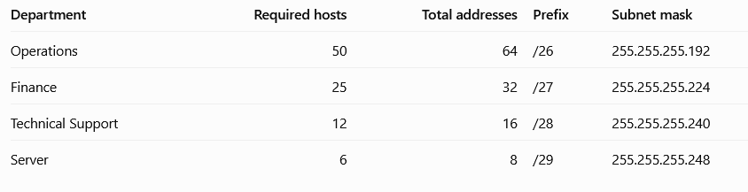
Example VLSM
Given network 192.168.50.0/24, the admin should use VLSM to allocate IP addresses efficiently according to each department’s requirements.
Determine the subnet sizes formula
Where h - number of host bits
H – required usable host addresses
2 – reserved addresses

Slide 24
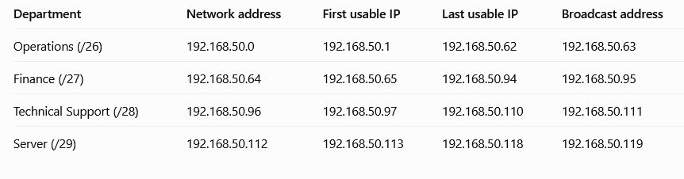
Continuation

Slide 25
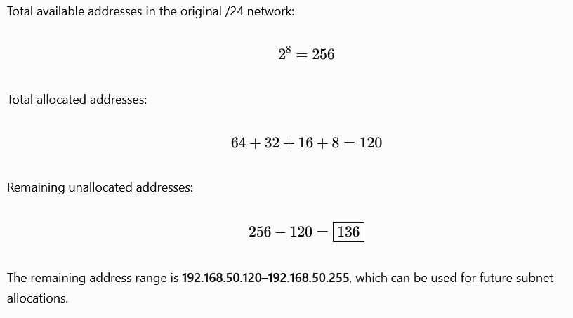

Slide 27
Topic 3 IP Addressing Lab Guide
All devices on a network, whether they are end systems like laptops and servers or networking equipment like switches and routers, communicate with each other using different forms of addresses. On an Ethernet network, each device has a globally unique address that is normally assigned during manufacturing. Thus, it is often times known as the hardware or physical address. This 48-bit address is actually called the Media Access Control (MAC) address and is expressed in hexadecimal format, e.g.
AA:BB:CC:12:34:56. Under the OSI Reference Model, it is aligned at the Data layer (Layer 2). Though it is a flat address without any hierarchy, it is based on a centrally assigned model, whereby the first six hexadecimal characters identify the manufacturer and are issued by the Institute for Electrical and Electronics Engineers (IEEE). This portion of the MAC is known as the Organizationally Unique Identifier (OUI). The last six remaining hexadecimal characters are assigned by each manufacturer independently. The MAC address is important because it is the address that devices actually use to deliver packets to each other on a physical wire.
As opposed to the burned-in MAC address, an IP address is a logical address that can be assigned and changed at will on a device. Under the OSI Reference Model, it is considered as the Network layer (Layer 3). It is hierarchical and is assigned based on the network where the device resides. For TCP/IP applications (e.g. web browsers, online games, etc…), it is the IP address that is used for communication, whether it is between adjacent devices or devices on different sides of the world. The application data, along with the source and destination IP addresses, is encapsulated within a frame that contains the source and destination MAC addresses, before the frame is sent onto the wire to the next hop.
To summarize, all Ethernet frames that are sent on a network wire contain the source and destination MAC addresses on the outermost layer of the frames. The next layer of the frames contains the source and destination IP addresses, if the frames are for a TCP/IP application. Actual application data is contained in an even deeper layer.
In this lab, we will go through a series of tasks to demonstrate the nature of MAC and IP addresses. In the interest of time, the lab has been pre-populated with the necessary equipment. The tasks will include:
Task 1: Assign interface Vlan1 on Switch1 and its hosts to IP addresses within the subnet 10.10.1.0/24
Task 2: Assign interface Vlan1 on Switch2 and its hosts to IP addresses within the subnet 10.10.1.0/24
Task 3: Re-assign interface Vlan1 on Switch2 and its hosts to subnet 10.10.2.0/24
Task 4: Enable ports Gig0/0 and Gig0/1 on Router1. Assign Gig0/0 to subnet 10.10.1.0/24 and Gig0/1 to subnet 10.10.2.0/24
Task 5: Ensure all switches, routers and end hosts can ping each other's IP address

Slide 28
Task 1: Assign interface Vlan1 on Switch1 and its hosts to IP addresses within the subnet 10.10.1.0/24
In this task, we will assign IP addresses to interface Vlan1 on Switch1 and its connected hosts. We will verify the MAC and IP addresses of these systems, as well as the connectivity among them.
Assign IP addresses to Laptop1 and Laptop2 on the FastEthernet0 interface under Config for each host.
  Laptop1 should have IP address 10.10.1.1 with subnet mask of 255.255.255.0
  Laptop2 should have IP address 10.10.1.2 with subnet mask of 255.255.255.0
Assign the IP address 10.10.1.11 to interface Vlan1 on Switch1 using the CLI.
  enable
  configure terminal
  interface vlan1
  ip address 10.10.1.11 255.255.255.0
  no shutdown
  end
  copy run start
Verify that all systems can communicate with each other. On Laptop1, perform these steps via the Command Prompt under Desktop and verify that the pings are successful.
  ping 10.10.1.2
  ping 10.10.1.11
Record the MAC and IP addresses of Switch1 and its connected hosts. This can be accomplished on Laptop1 via the command “arp -a” on the Command Prompt, which displays the ARP table.
The ARP process is a mechanism used by devices to query for the MAC address that corresponds to an IP address since a device needs the MAC address in order to communicate with other
devices on the wire. Under the “arp -a” output, the “Internet Address” is the IP address and the
“Physical Address” is the MAC address. The IP and MAC addresses of Laptop1 itself can be obtained via the command “ipconfig /all”.
  Laptop1: IP Address: , MAC:
  Laptop2: IP Address: , MAC:
  Switch1: IP Address: , MAC:
Task 2: Assign interface Vlan1 on Switch2 and its hosts to IP addresses within the subnet 10.10.1.0/24
In this task, we will expand the network created in Task 1. Assign IP addresses to interface Vlan1 on Switch2 and its connected hosts. We will verify the MAC and IP addresses of these systems, as well as the connectivity among the laptops and switches.
Assign IP addresses to Laptop3 and Laptop4 on the FastEthernet0 interface under Config for each host.
  Laptop3 should have IP address 10.10.1.3 with subnet mask of 255.255.255.0
  Laptop4 should have IP address 10.10.1.4 with subnet mask of 255.255.255.0
Assign the IP address 10.10.1.12 to interface Vlan1 on Switch2 using the CLI.

Slide 29
enable
configure terminal
interface vlan1
ip address 10.10.1.12 255.255.255.0
no shutdown
end
copy run start
Verify that all systems can communicate with each other. On Laptop1, perform these steps via the Command Prompt under Desktop and verify that the pings are successful.
  ping 10.10.1.2
  ping 10.10.1.3
  ping 10.10.1.4
  ping 10.10.1.11
  ping 10.10.1.12
Record the MAC and IP addresses of all the laptops and switches. This can be accomplished on Laptop1 via the command “arp -a” on the Command Prompt. The “Internet Address” is the IP address and the “Physical Address” is the MAC address. The IP and MAC addresses of Laptop1 itself can be obtained via the command “ipconfig /all”.
  Laptop1: IP Address: , MAC:
  Laptop2: IP Address: , MAC:
  Laptop3: IP Address: , MAC:
  Laptop4: IP Address: , MAC:
  Switch1: IP Address: , MAC:
  Switch2: IP Address: , MAC:
Task 3: Re-assign interface Vlan1 on Switch2 and its hosts to subnet 10.10.2.0/24
In this task, we will re-assign the IP addresses to interface Vlan1 on Switch2 and Laptop3 and Laptop4. We will examine the MAC and IP addresses of these systems, as well as how connectivity among the laptops and switches have changed.
Assign IP addresses to Laptop3 and Laptop4 on the FastEthernet0 interface under Config for each host.
  Laptop3 should have IP address 10.10.2.3 with subnet mask of 255.255.255.0
  Laptop4 should have IP address 10.10.2.4 with subnet mask of 255.255.255.0
Assign the IP address 10.10.2.12 to interface Vlan1 on Switch2 using the CLI.
  enable
  configure terminal
  interface vlan1
  ip address 10.10.2.12 255.255.255.0
  no shut
  end
  copy run start

Slide 30
Let’s examine how connectivity between the switches and laptops has changed. On Laptop1, perform the following ping tests via the Command Prompt under Desktop. Which pings are successful and which are not?
  ping 10.10.1.2
  ping 10.10.1.11
  ping 10.10.2.3
  ping 10.10.2.4
  ping 10.10.2.12
On Laptop3, perform these similar ping tests. Which pings are successful and which are not?
  ping 10.10.1.1
  ping 10.10.1.2
  ping 10.10.1.11
  ping 10.10.2.4
  ping 10.10.2.12
For Step 3, all ping tests to addresses within the subnet 10.10.2.X should have failed. Ping is a TCP/IP application and the change in logical IP network for Switch2 and its connected laptops (Laptop3 and Laptop4) would cause the ping tests to fail on Laptop1 in this situation, even though the physical wiring has not changed. Although we changed the IP addresses on Switch2 and its connected laptops, would the MAC addresses for those devices have changed as well? Let’s examine by using the “arp –a” and “ipconfig /all” commands on Laptop1. Notice that Laptop1 does not display any information for hosts within the 10.10.2.x subnet, while still displaying stale information regarding Switch2 and its connected laptops.
  Laptop1: IP Address: , MAC:
  Laptop2: IP Address: , MAC:
  Switch1: IP Address: , MAC:
Similarly for Step 4, Laptop3 would have failed to successfully ping all addresses on the 10.10.1.x subnet. Let’s see what Laptop3 knows about its neighbors’ IP and MAC addresses. Use the “arp –a” and “ipconfig /all” commands on Laptop3 to obtain the following information.
  Laptop3: IP Address: , MAC:
  Laptop4: IP Address: , MAC:
  Switch2: IP Address: , MAC:
Compare the IP and MAC address information from Laptop1 and Laptop3 with that of Step 4 of Task 2. Notice that although the IP addresses have changed, all of the MAC addresses are still the same. This is because MAC addresses are ultimately the addresses used by devices for communicating on the physical wire but successful communication for applications will need to take into account higher layer information like IP addresses.
Task 4: Enable ports Gig0/0 and Gig0/1 on Router1. Assign Gig0/0 to subnet 10.10.1.0/24 and Gig0/1 to subnet 10.10.2.0/24
In this task, we will enable the ports on Router1 and assign them to the proper subnets. We will then examine if all switches and routers can communicate with each other after enabling Router1.

Slide 31
Using the CLI on Router1, enable Gig0/0 and assign it the address 10.10.1.254 with subnet mask 255.255.255.0. Enable Gig0/1 and assign it the IP address 10.10.2.254 with subnet mask 255.255.255.0.
  enable
  configure terminal
  interface gig0/0
  ip address 10.10.1.254 255.255.255.0
  no shutdown
  exit
  interface gig0/1
  ip address 10.10.2.254 255.255.255.0
  no shutdown
  end
  copy run start
Verify that Router1 can successfully ping all switches and laptops. Successful pings are indicated by exclamation points.
  ping 10.10.1.1
  ping 10.10.1.2
  ping 10.10.1.11
  ping 10.10.2.3
  ping 10.10.2.4
  ping 10.10.2.12
On Router1, record the IP and MAC address information for all devices, including Router1 itself, using the CLI command “show ip arp”. The dash (“-“) under the “Age (min)” column indicates that the information is local to the device. Note that the IP and MAC addresses are still the same from Task 3. This is expected since we have not changed the configuration on the switches and routers.
  Laptop1: IP Address: , MAC:
  Laptop2: IP Address: , MAC:
  Laptop3: IP Address: , MAC:
  Laptop4: IP Address: , MAC:
  Switch1: IP Address: , MAC:
  Switch2: IP Address: , MAC:
  Router1, Gig0/0: IP Address: , MAC:
  Router1, Gig0/1: IP Address: , MAC:
Now that we have enabled Router1 and it is able to ping all switches and laptops on the network, does this mean that connectivity between all laptops and switches have been restored? Let’s examine by running our ping tests on Laptop1. Are all the tests successful?
  ping 10.10.1.2
  ping 10.10.1.11
  ping 10.10.1.254
  ping 10.10.2.3
  ping 10.10.2.4
  ping 10.10.2.12

Slide 32
g. ping 10.10.2.254
Similarly, run the ping tests on Laptop3. Which pings are successful and which are not?
  ping 10.10.1.1
  ping 10.10.1.2
  ping 10.10.1.11
  ping 10.10.1.254
  ping 10.10.2.4
  ping 10.10.2.12
  ping 10.10.2.254
Task 5: Ensure all switches, routers and end hosts can ping each other's IP address
Steps 4 and 5 of Task 4 show us that connectivity between all devices have not been restored even after enabling Router1 within the network. This is because hosts connected to switches 1 and 2 are on different logical IP network despite being in the same broadcast domain. Devices on different logical IP networks need to know the intermediary device that will assist in the communication across these logical networks. A router is designed to function in this capacity, known as the gateway, but hosts need to be configured to send information destined for different logical networks to the router in order for the communication to be successful.
Configure Laptop1 and Laptop2 to use Router1 Gig0/0 as the gateway address.
  Under the Global Config for Laptop1, enter 10.10.1.254 as the Gateway address (not IPv6 Gateway).
  Under the Global Config for Laptop2, enter 10.10.1.254 as the Gateway address (not IPv6 Gateway).
Configure Laptop2 and Laptop3 to use Router1 Gig0/1 as the gateway address.
  Under the Global Config for Laptop3, enter 10.10.2.254 as the Gateway address (not IPv6 Gateway).
  Under the Global Config for Laptop4, enter 10.10.1.254 as the Gateway address (not IPv6 Gateway).
Using the CLI, configure the default gateway for Switch1.
  enable
  configure terminal
  ip default-gateway 10.10.1.254
  end
  copy run start
Using the CLI, configure the default gateway for Switch2.
  enable
  configure terminal
  ip default-gateway 10.10.2.254
  end
  copy run start

Slide 33
Verify that communication for all devices have been restored by running our ping tests on Laptop1. Clear the ARP table before running the ping tests. All ping tests should be successful.
  arp -d
  ping 10.10.1.2
  ping 10.10.1.11
  ping 10.10.1.254
  ping 10.10.2.3
  ping 10.10.2.4
  ping 10.10.2.12
  ping 10.10.2.254
View the ARP table on Laptop1. Note that although Laptop1 can now reach all devices on the network, its ARP table only has information for devices within its own logical IP network. Communication with devices outside of its logical network would go through Router1. Hence, all frames sent to other logical networks would contain the Gig0/0 MAC address of Router1 as the destination MAC address once they are sent on the wire, while the destination IP address contained in those frames would be that of the remote device. When Router1 receives the frames from Laptop1 and forwards them along, it will change the source MAC address to that of its Gig0/1 interface and the destination MAC address to that of the intended host on the
10.10.2.x logical network. The source and destination IP addresses of the frames remain unchanged.

